Slide 1

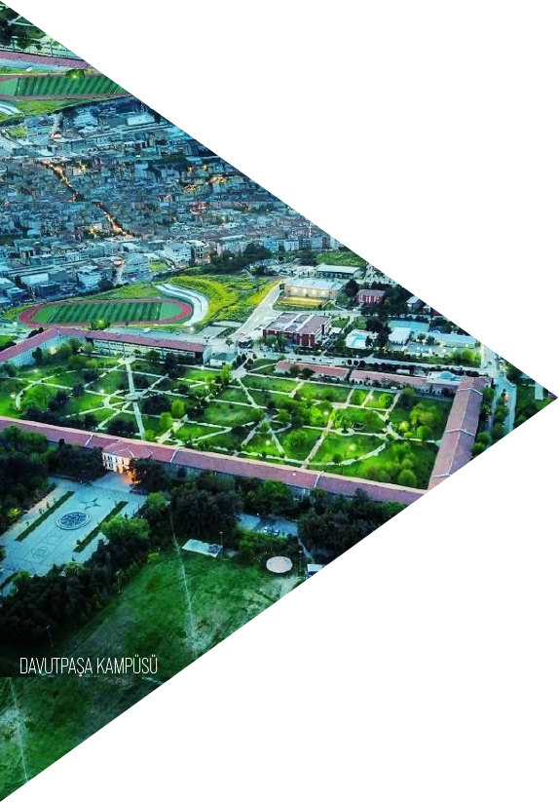
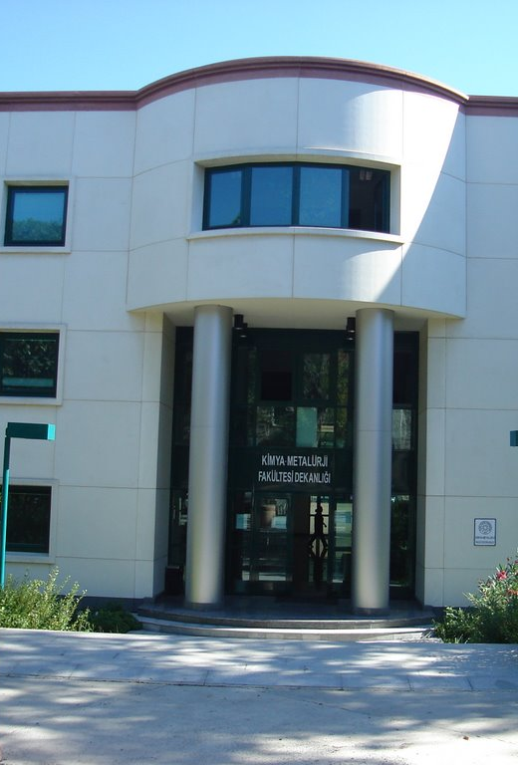
FACULTY OF CHEMICAL-METALLURGICAL
DEPARTMENT OF BIOENGINEERING

Slide 2

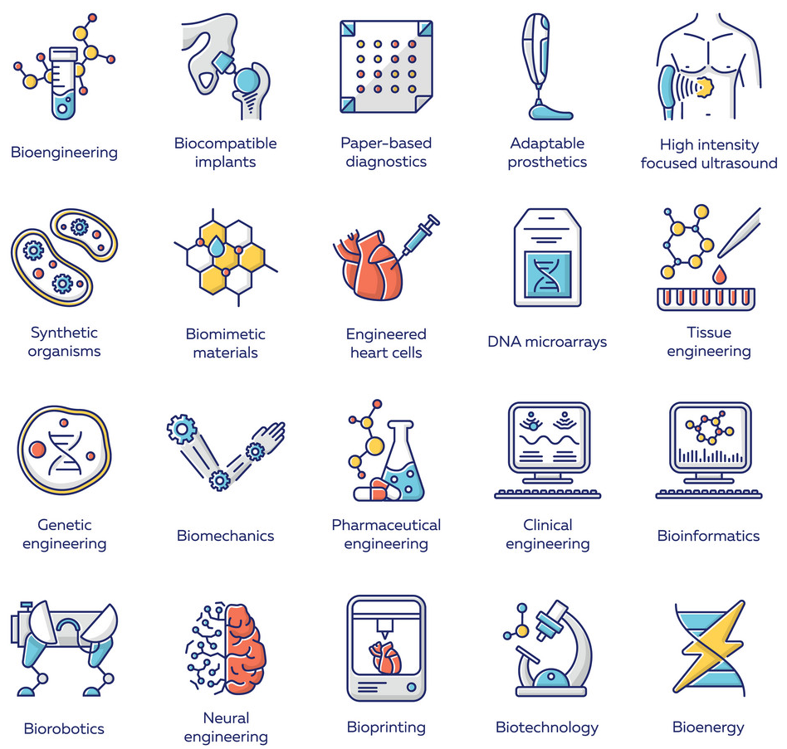
ABOUT BIOENGINEERING
Bioengineering; is a unique branch of engineering that finds solutions with a multi-disciplinary perspective by using the principles of engineering and natural sciences for problems in medicine and life sciences, and aims to improve the life quality of people by using developments in different fields of engineering science, new techniques and tools.
YTU FACULTY OF CHEMICAL-METALLURGICAL
ENGINEERING
DEPARTMENT OF BIOENGINEERING

Slide 3

MÜDEK
MÜDEK (Association for Evaluation and Accreditation of Engineering Programs) is an independent organization that conducts accreditation, evaluation, and information activities for engineering education programs across various disciplines. MÜDEK is dedicated to enhancing the quality of engineering education through its accreditation and quality assurance processes.
YTU FACULTY OF CHEMICAL-METALLURGICAL
ENGINEERING
DEPARTMENT OF BIOENGINEERING

Slide 4

BIOENGINEERING (2025-2026 ACADEMIC YEAR)
UNDERGRADUATE
STUDENT
DEPARTMENTS
FOUNDED YEAR
BACHELOR’S DEGREE
2003
893
195
1
LABORATORIES
UNDERGRADUATE
PROGRAM
GRADUATE STUDENT
MASTER'S GRADUATES
FACULTY MEMBERS
15
2
109
48
22
LABORATORY
AREA
GRADUATE
PROGRAM
PHD STUDENT
PHD GRADUATES
RESEARCH ASSISTANTS
1240m²
1
106
23
12
DOCTORAL
PROGRAM
FOREIGN STUDENT
Established as an academic department within the Graduate School of Natural and Applied Sciences, the Department of Bioengineering admitted its first master's students in the Fall semester of the 2003–2004 academic year. Since the 2007–2008 academic year, it has been offering undergraduate and graduate programs.
1
89
YTU FACULTY OF CHEMICAL-METALLURGICAL
ENGINEERING
DEPARTMENT OF BIOENGINEERING

Slide 5


EDUCATION
PROFILE OF STUDENTS ADMITTED TO THE UNDERGRADUATE PROGRAM
Preference Ranking for Admission to the Undergraduate % 100 Program
(YKS-2024)
%62,2
Preference Ranking for Admission to the Undergraduate % 30 Program
(YKS-2024)
Number of Students Enrolled in the Undergraduate Program
(2025)
%64,5
141
Undergraduate Program Occupancy Rate
(YKS-2024)
%100
YTU FACULTY OF CHEMICAL-METALLURGICAL
ENGINEERING
DEPARTMENT OF BIOENGINEERING

Slide 6

EDUCATION AND TRAINING
TARGETS
To combine theoretical knowledge with hands-on laboratory practice through our distinguished academic staff,
To promote collaboration with industry and entrepreneurship,
To encourage students' participation in research projects and scientific activities,
To strengthen national and international collaborations,
To ensure the continuity of accreditation,
To enhance the success of Erasmus student mobility programs, and
To increase the rate of achievement of program learning outcomes.
YTU FACULTY OF CHEMICAL-METALLURGICAL
ENGINEERING
DEPARTMENT OF BIOENGINEERING

Slide 7











R&D, INNOVATION AND ENTREPRENEURSHIP
THEMATIC RESEARCH AREAS
NANOTECHNOLOGY AND BIOSENSORS
LAB-ON-A-CHIP AND DIAGNOSTIC KIT
VACCINE AND
BIOPOLYMERS
BIOMATERIALS AND LIPIDS
TISSUE ENGINEERING
BIOENGINEERING
DEPARTMENT
ALGAL TECHNOLOGIES
CELL CULTURE SYSTEMS
ENVIRONMENT AND ENERGY
RECOMBINANT DNA TECHNOLOGIES
PLANT BIOTECHNOLOGY
YTU FACULTY OF CHEMICAL-METALLURGICAL
ENGINEERING
DEPARTMENT OF BIOENGINEERING

Slide 8
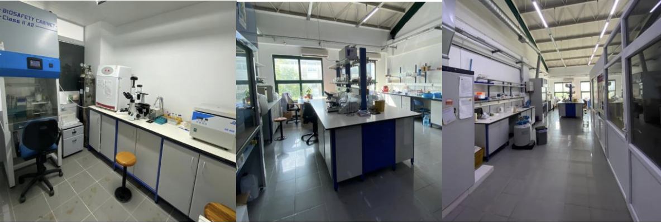
Engineering & Bioengineering Laboratory
Cell Biology and Genetic Engineering Laboratory
Recombinant DNA Technologies Laboratory
Polymeric Biomaterials and Macromolecular Synthesis Laboratory
Lipid and Biocomposite Laboratory
Applied Nanotechnology and Antibody Production Laboratory
Energy and Materials Laboratory
Algal Biotechnology and Bioprocess Laboratory
Cell Culture and Vaccine Laboratory
Plant Tissue Culture Laboratory
Biomaterials and Tissue Engineering Laboratory
Biopolymer and Vaccines Laboratory
Bionanotechnology and Biosensors Laboratory
Cell Culture and Tissue Engineering Laboratory
OUR LABORATORIES
YTU FACULTY OF CHEMICAL-METALLURGICAL
ENGINEERING
DEPARTMENT OF BIOENGINEERING

Slide 9
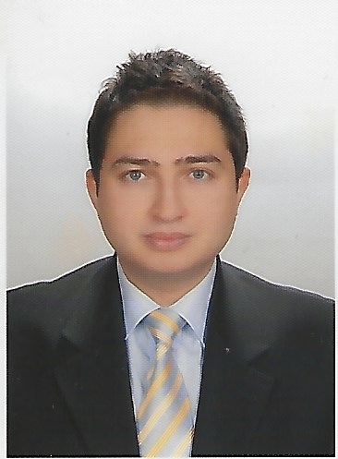

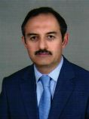
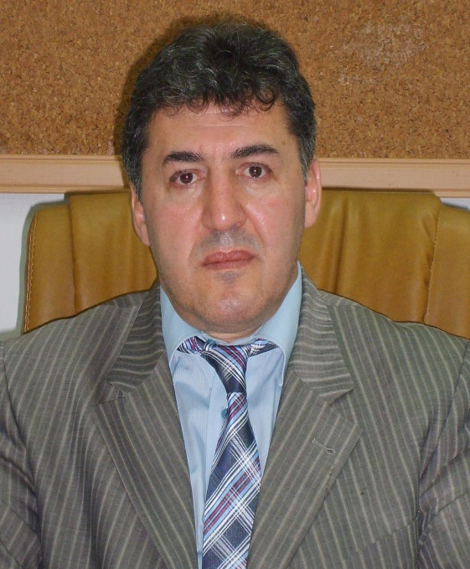
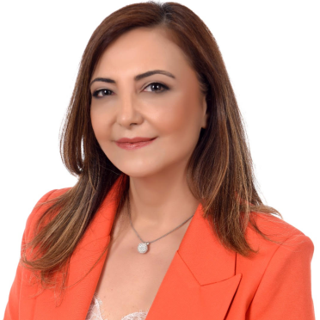

https://avesis.yildiz.edu.tr/
(To Access Information About Our Faculty Members and Course Materials)
ACADEMIC STAFF
Prof. Dr. Mehmet Burçin PİŞKİN
Prof. Dr. Dilek BALIK
Prof. Dr. Musa TÜRKER
Prof. Dr. İbrahim IŞILDAK
Prof. Dr. Sevil YÜCEL
Prof. Dr. Didem BALKANLI

Slide 10
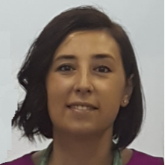
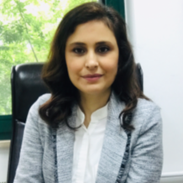
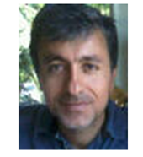
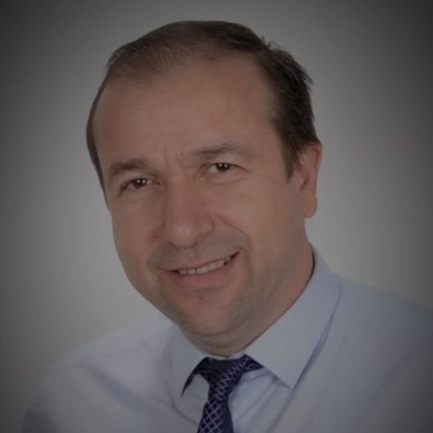
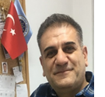
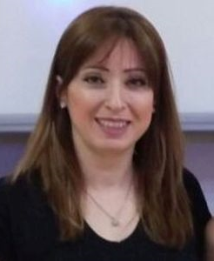
https://avesis.yildiz.edu.tr/
(To Access Information About Our Faculty Members and Course Materials)
ACADEMIC STAFF
Prof. Dr. Serap ACAR
Prof. Dr. Ayhan BİNGÖLBALİ
Prof. Dr. Rabia ÇAKIR
Prof. Dr. Cem Bülent ÜSTÜNDAĞ
Prof. Dr. Mehmet Murat ÖZMEN
Prof. Dr. Yasemin KILINÇ

Slide 11


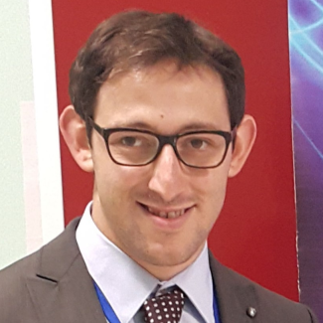
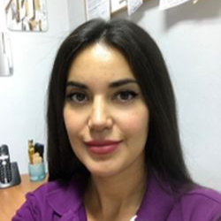
https://avesis.yildiz.edu.tr/
(To Access Information About Our Faculty Members and Course Materials)
ACADEMIC STAFF
Doç. Dr. Özlem DOĞAN AYDENİZ
Doç. Dr. Murat TOPUZOĞULLARI
Doç. Dr. Emrah Şefik ABAMOR
Doç. Dr. Azade ATTAR

Slide 12
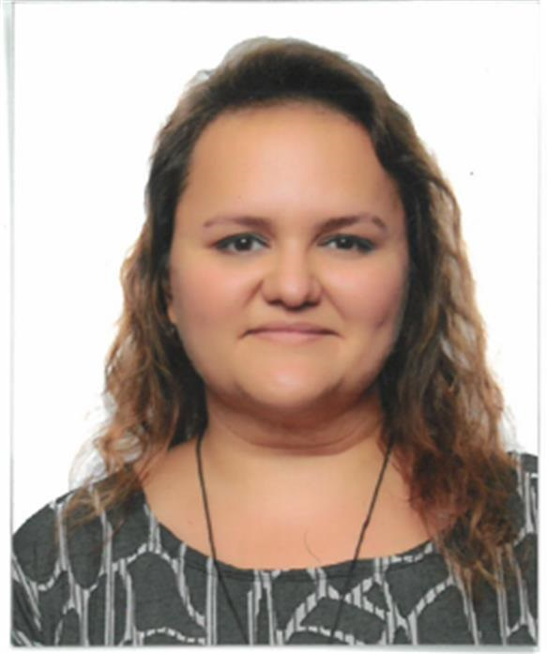
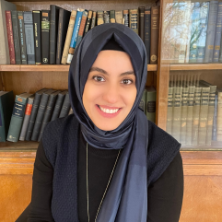
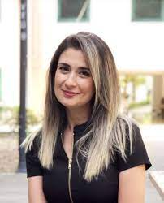
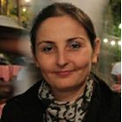
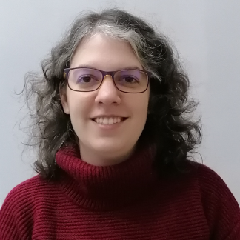
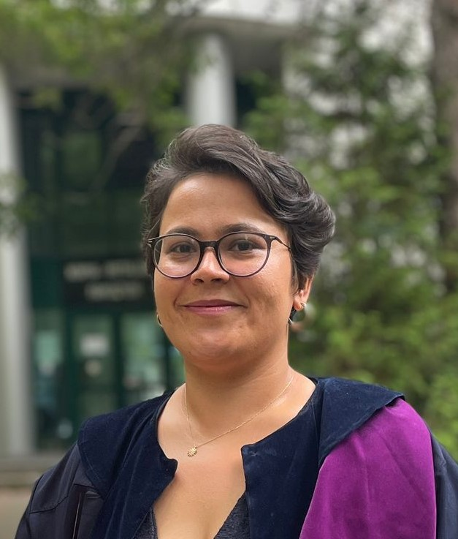
https://avesis.yildiz.edu.tr/
(To Access Information About Our Faculty Members and Course Materials)
ACADEMIC STAFF
Doç. Dr. Fatma Tuğçe ŞENBERBER DUMANLI
Doç. Dr. Esma AHLATÇIOĞLU ÖZEROL
Doç. Dr. Azime ERARSLAN
Dr. Öğr. Üyesi Yeliz ELALMIŞ
Dr. Öğr. Üyesi Benan İNAN
Dr. Öğr. Üyesi Selcen ARI YUKA

Slide 13
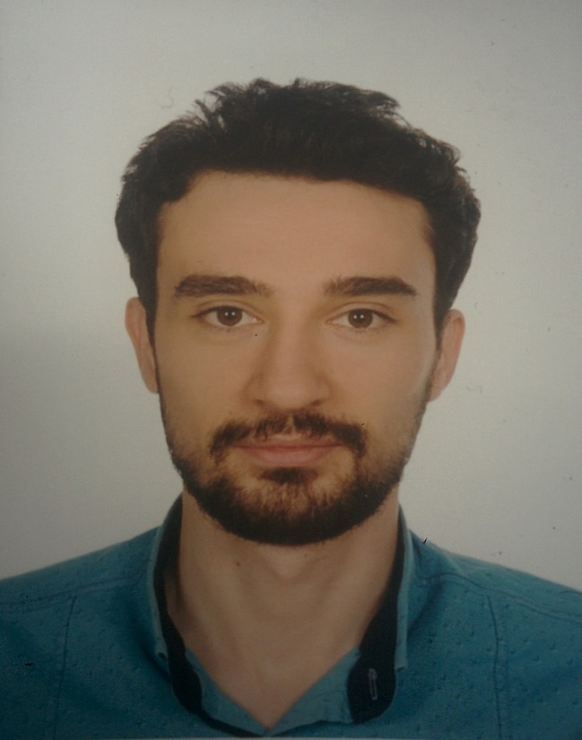
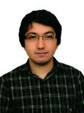
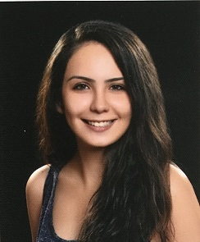
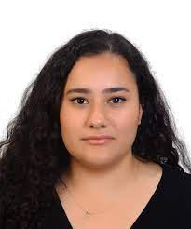
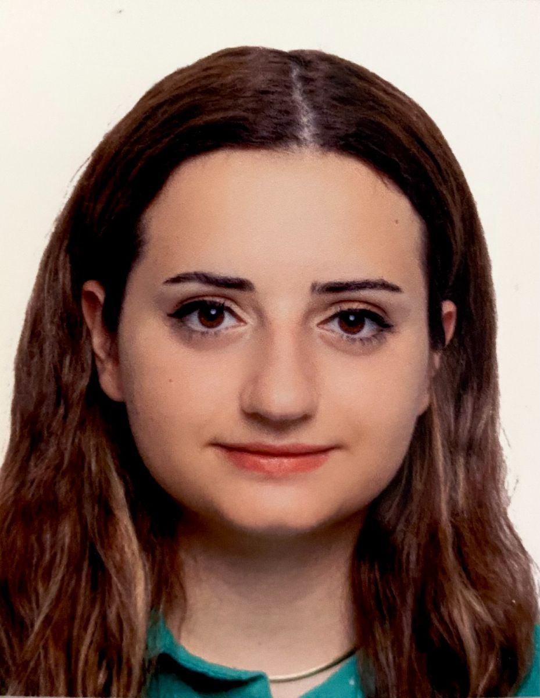
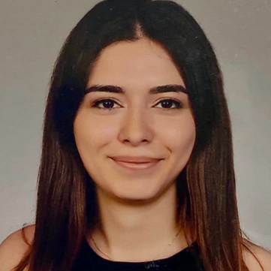
ACADEMIC STAFF
Arş. Gör. Dr. Mustafa NİĞDE
Arş. Gör. Ayça ASLAN
Arş. Gör. Cem ÖZEL
Arş. Gör. Gülcan Ayşin KARACA
Arş. Gör. Eda Nur YETİŞKİN MORKAN
Arş. Gör. Hilal ÇALIK

Slide 14
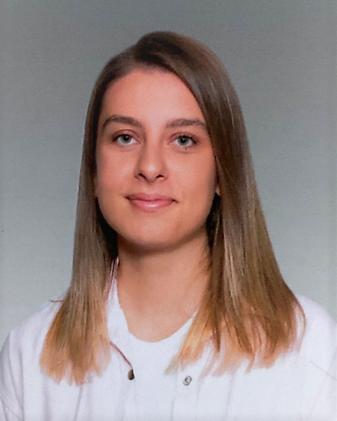
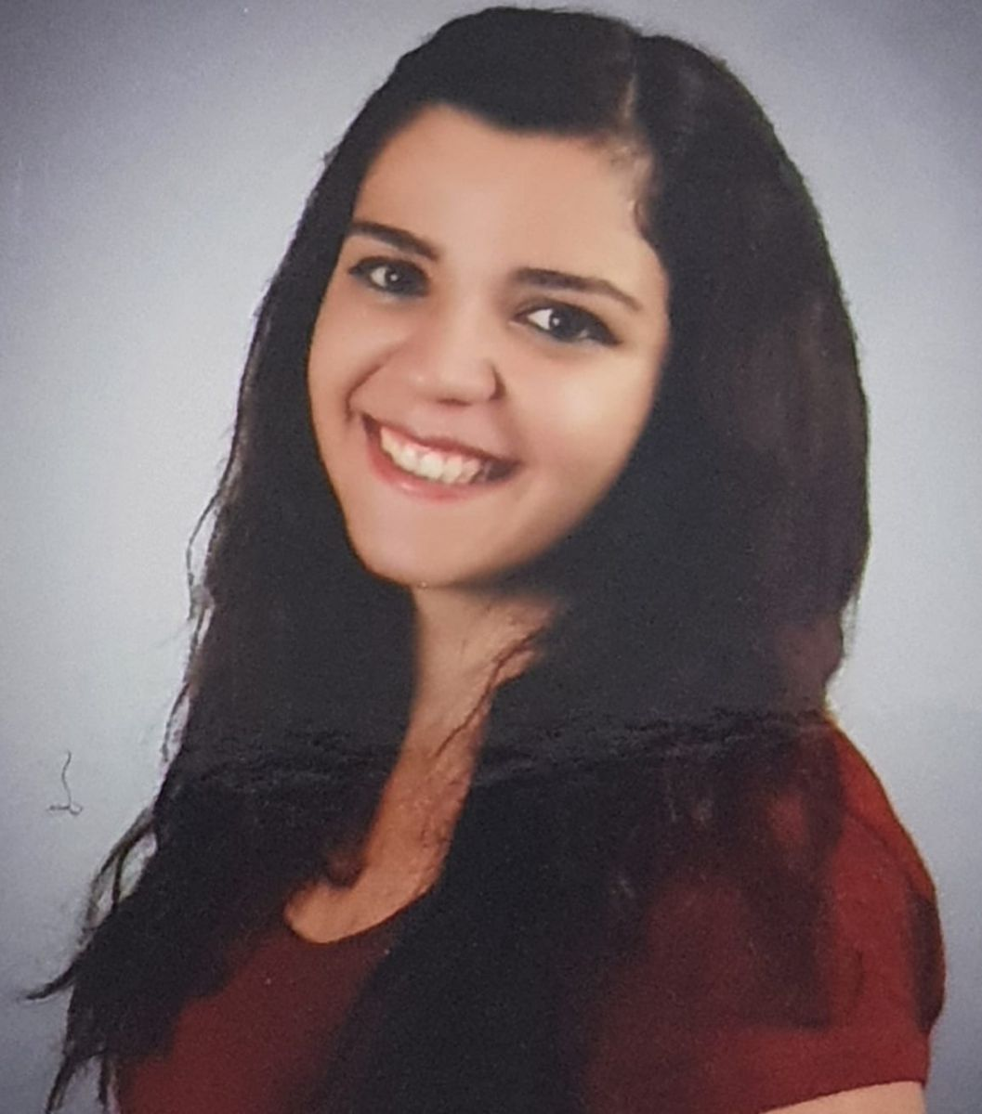
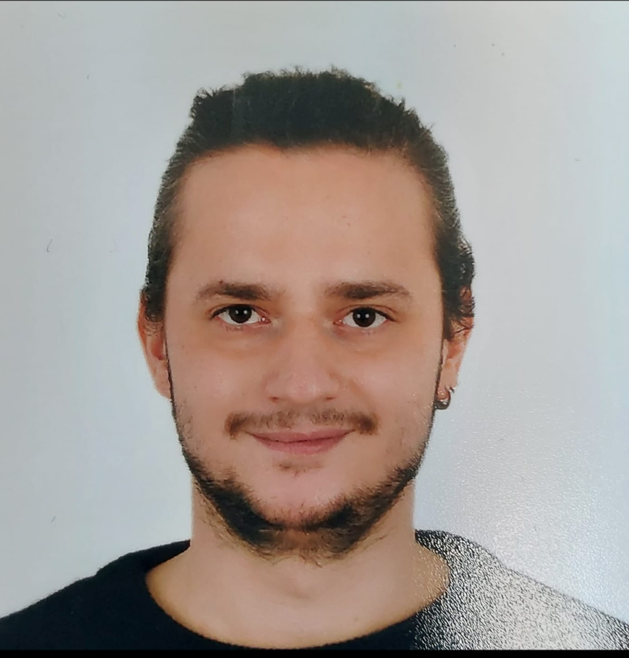
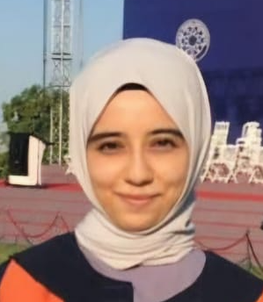
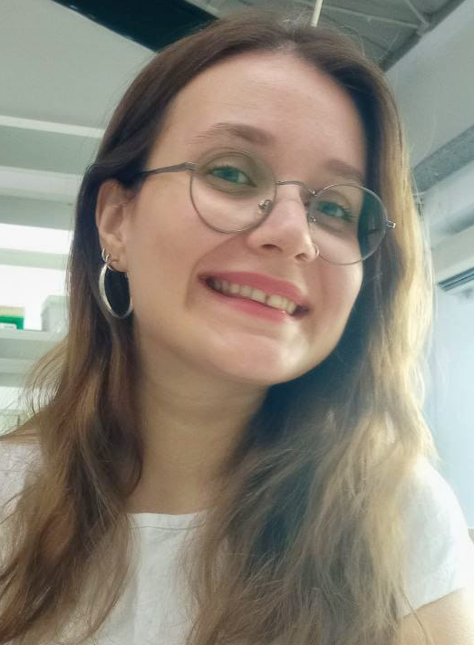
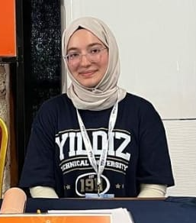
ACADEMIC STAFF
Arş. Gör. Beyza KARACAOĞLU
Arş. Gör. Selcan AKAR
Arş. Gör. Yücel Taha UŞA
Arş. Gör. Elif Nur YILDIZ
Arş. Gör. Nurseda SÜRGİT
Arş. Gör. Zişan TOPRAK

Slide 15
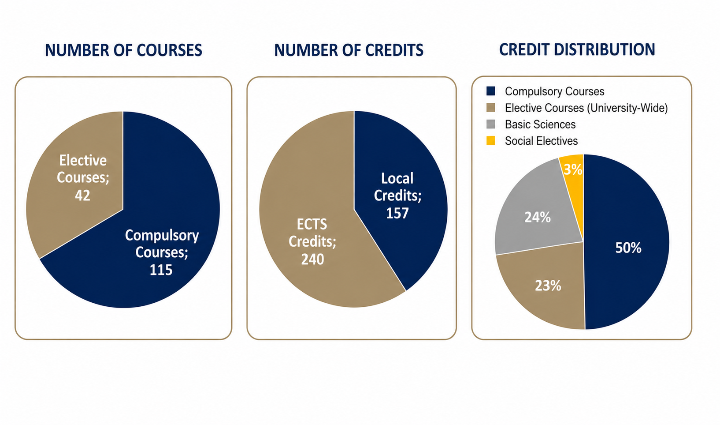
EDUCATION AND TRAINING
BOLOGNA 2024 CURRICULUM
YTU FACULTY OF CHEMICAL-METALLURGICAL
ENGINEERING
DEPARTMENT OF BIOENGINEERING

Slide 16
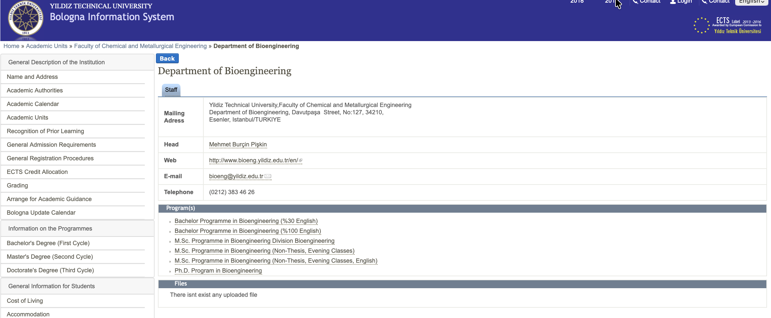
http://bologna.yildiz.edu.tr/index.php?r=program/view&id=147&aid=26
http://bologna.yildiz.edu.tr/index.php?r=program/view&id=163&aid=26
Course Information and Syllabus
EĞİTİM VE ÖĞRETİM
BOLOGNA 2024
YTU FACULTY OF CHEMICAL-METALLURGICAL
ENGINEERING
DEPARTMENT OF BIOENGINEERING

Slide 17
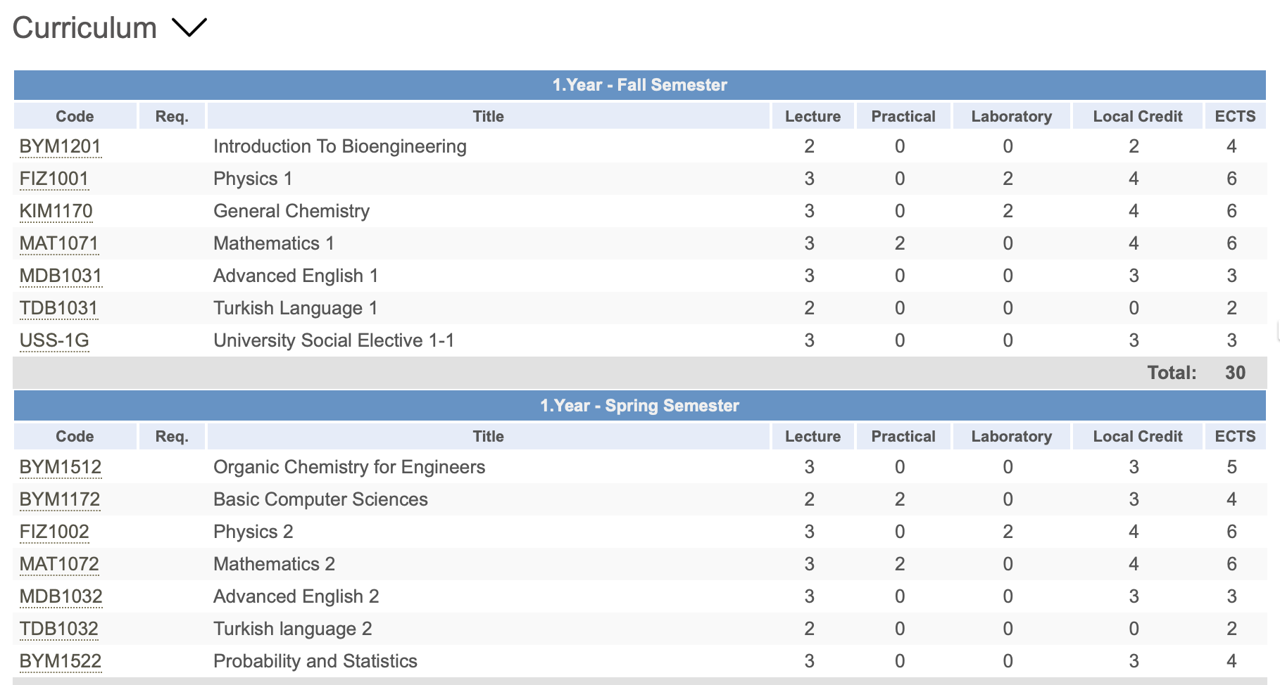
EDUCATION AND TRAINING
BOLOGNA 2024 CURRICULUM
YTU FACULTY OF CHEMICAL-METALLURGICAL
ENGINEERING
DEPARTMENT OF BIOENGINEERING

Slide 18
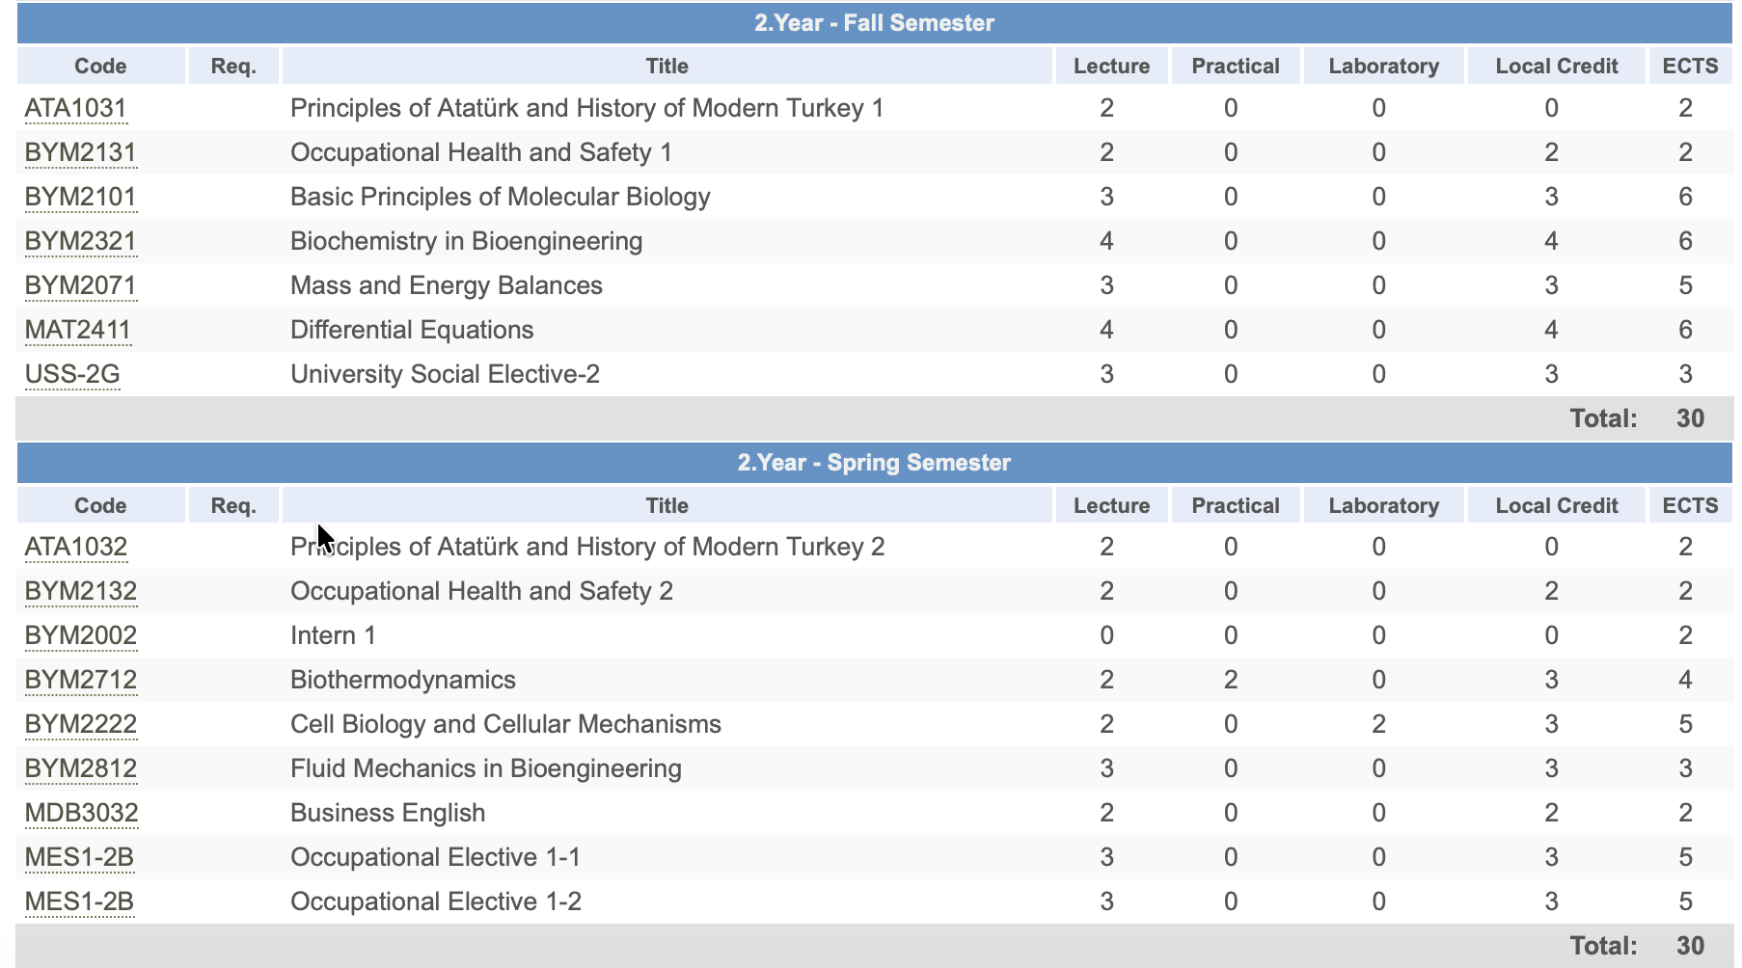
EDUCATION AND TRAINING
BOLOGNA 2024 CURRICULUM
YTU FACULTY OF CHEMICAL-METALLURGICAL
ENGINEERING
DEPARTMENT OF BIOENGINEERING

Slide 19
EDUCATION AND TRAINING
BOLOGNA 2024 CURRICULUM
YTU FACULTY OF CHEMICAL-METALLURGICAL
ENGINEERING
DEPARTMENT OF BIOENGINEERING

Slide 20
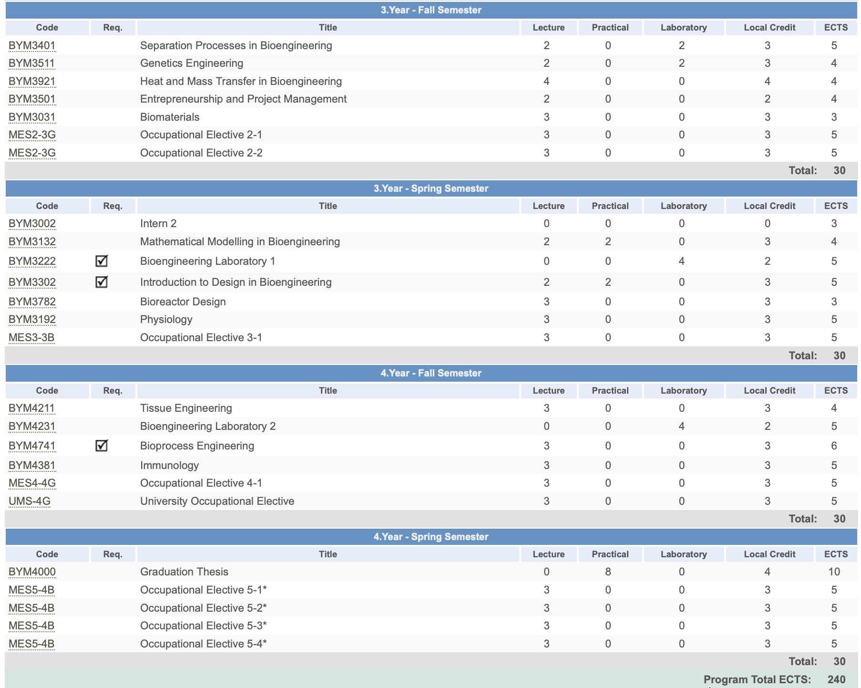
EDUCATION AND TRAINING
BOLOGNA 2024
CURRICULUM
YTU FACULTY OF CHEMICAL-METALLURGICAL
ENGINEERING
DEPARTMENT OF BIOENGINEERING

Slide 21
EDUCATION AND TRAINING
www.bioeng.yildiz.edu.tr
(For All Department Announcements (Course Schedules, Examination Timetables, Course Add/Drop Announcements, Petition Notices, etc.)
www.ogi.yildiz.edu.tr
(For All Questions Regarding Course Registration, Course Selection, Regulations, and Academic Policies)
www.yildiz.edu.tr
(For University Announcements)
YTU FACULTY OF CHEMICAL-METALLURGICAL
ENGINEERING
DEPARTMENT OF BIOENGINEERING
Y

Slide 22
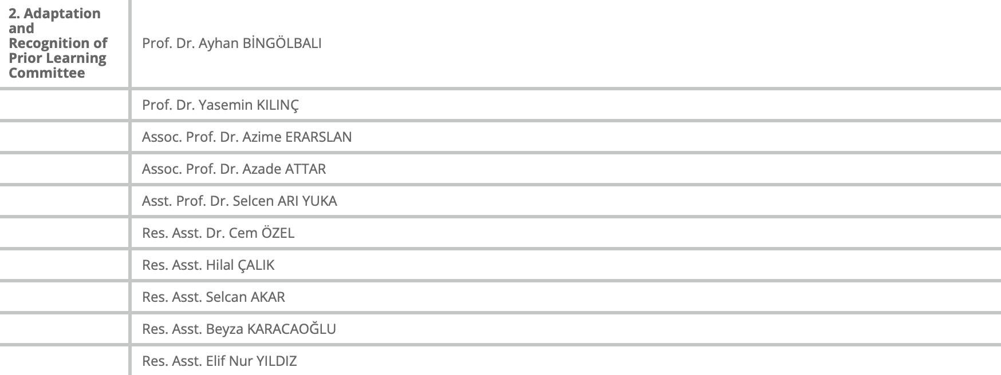
EDUCATION AND TRAINING
COMMISSIONS
YTU FACULTY OF CHEMICAL-METALLURGICAL
ENGINEERING
DEPARTMENT OF BIOENGINEERING
Y.T.Ü. KİMYA-METALÜRJİ FAKÜLTESİ
BİYOMÜHENDİSLİK BÖLÜMÜ

Slide 23
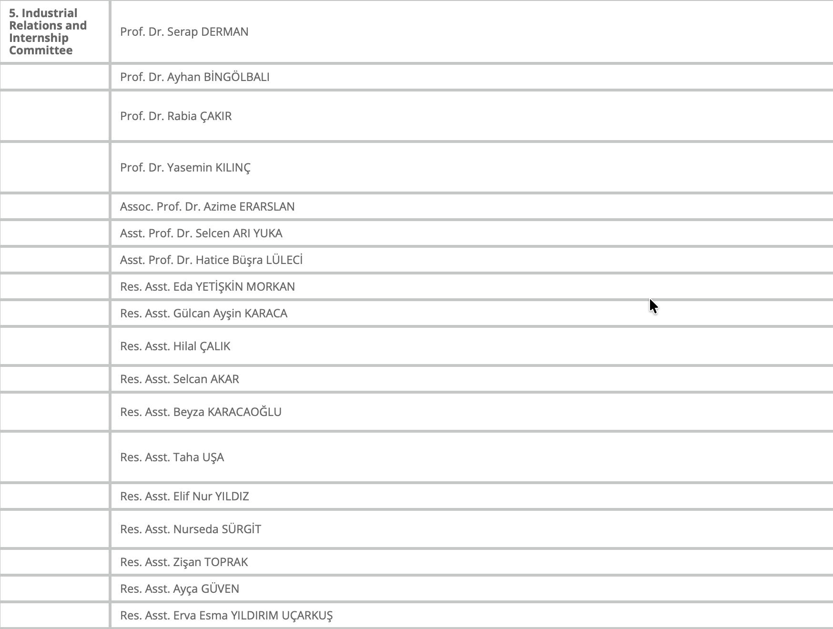
EDUCATION AND TRAINING
COMMISSIONS
YTU FACULTY OF CHEMICAL-METALLURGICAL
ENGINEERING
DEPARTMENT OF BIOENGINEERING

Slide 24
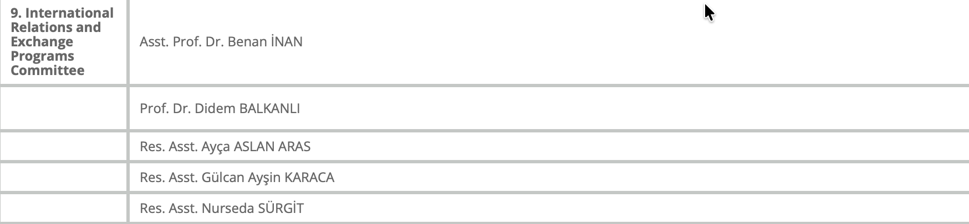
EDUCATION AND TRAINING
COMMISSIONS
YTU FACULTY OF CHEMICAL-METALLURGICAL
ENGINEERING
DEPARTMENT OF BIOENGINEERING
Y.T.Ü. KİMYA-METALÜRJİ FAKÜLTESİ
BİYOMÜHENDİSLİK BÖLÜMÜ

Slide 25
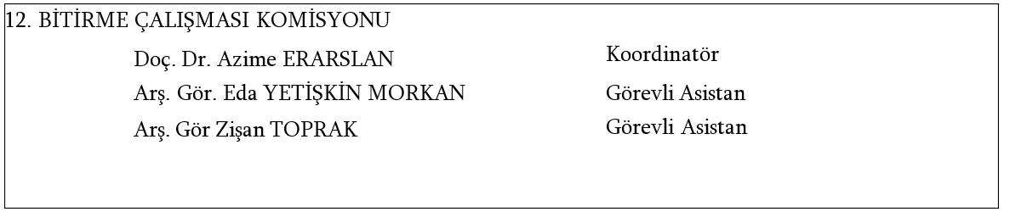
EDUCATION AND TRAINING
COMMISSIONS
GRADUATION PROJECT COMMITTEE
YTU FACULTY OF CHEMICAL-METALLURGICAL
ENGINEERING
DEPARTMENT OF BIOENGINEERING
Y.T.Ü. KİMYA-METALÜRJİ FAKÜLTESİ
BİYOMÜHENDİSLİK BÖLÜMÜ

Slide 26
EDUCATION AND TRAINING
INTERNSHIP
Compulsory Internship
20 Working Days – Laboratory Internship
20 Working Days – Industrial Internship
The laboratory internship must be completed before the industrial internship.
Students are responsible for securing their own internship placements. However, they may also refer to the list of organizations where previous students have completed their internships.
Students may also complete their internships abroad through the Erasmus+ Programme or by making their own arrangements.
Detailed information regarding internship procedures and requirements is available on the Department's website.
YTU FACULTY OF CHEMICAL-METALLURGICAL
ENGINEERING
DEPARTMENT OF BIOENGINEERING

Slide 27
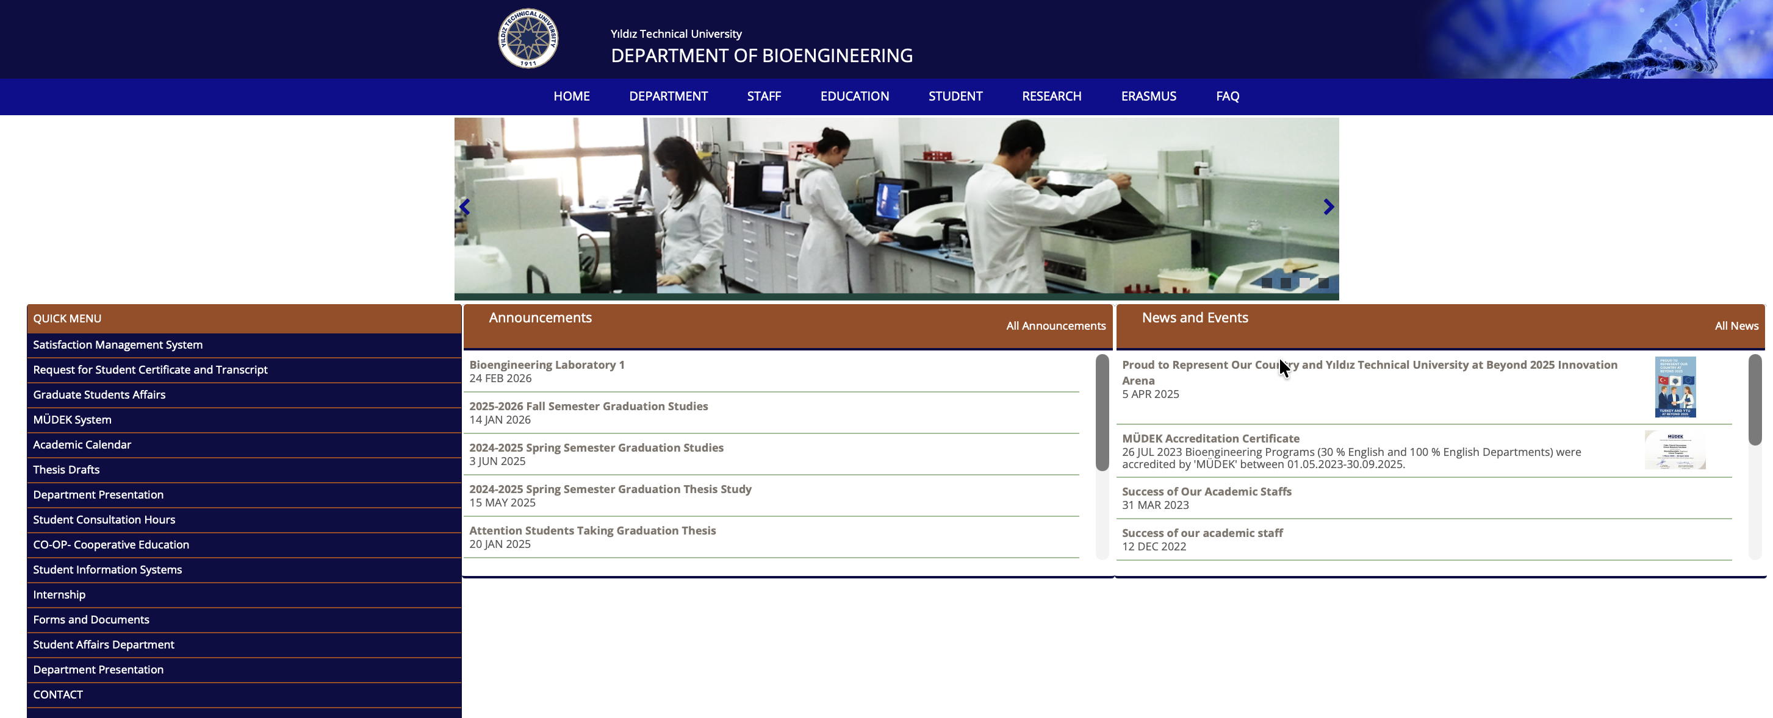
EDUCATION AND TRAINING
INTERNSHIP
YTU FACULTY OF CHEMICAL-METALLURGICAL
ENGINEERING
DEPARTMENT OF BIOENGINEERING

Slide 28
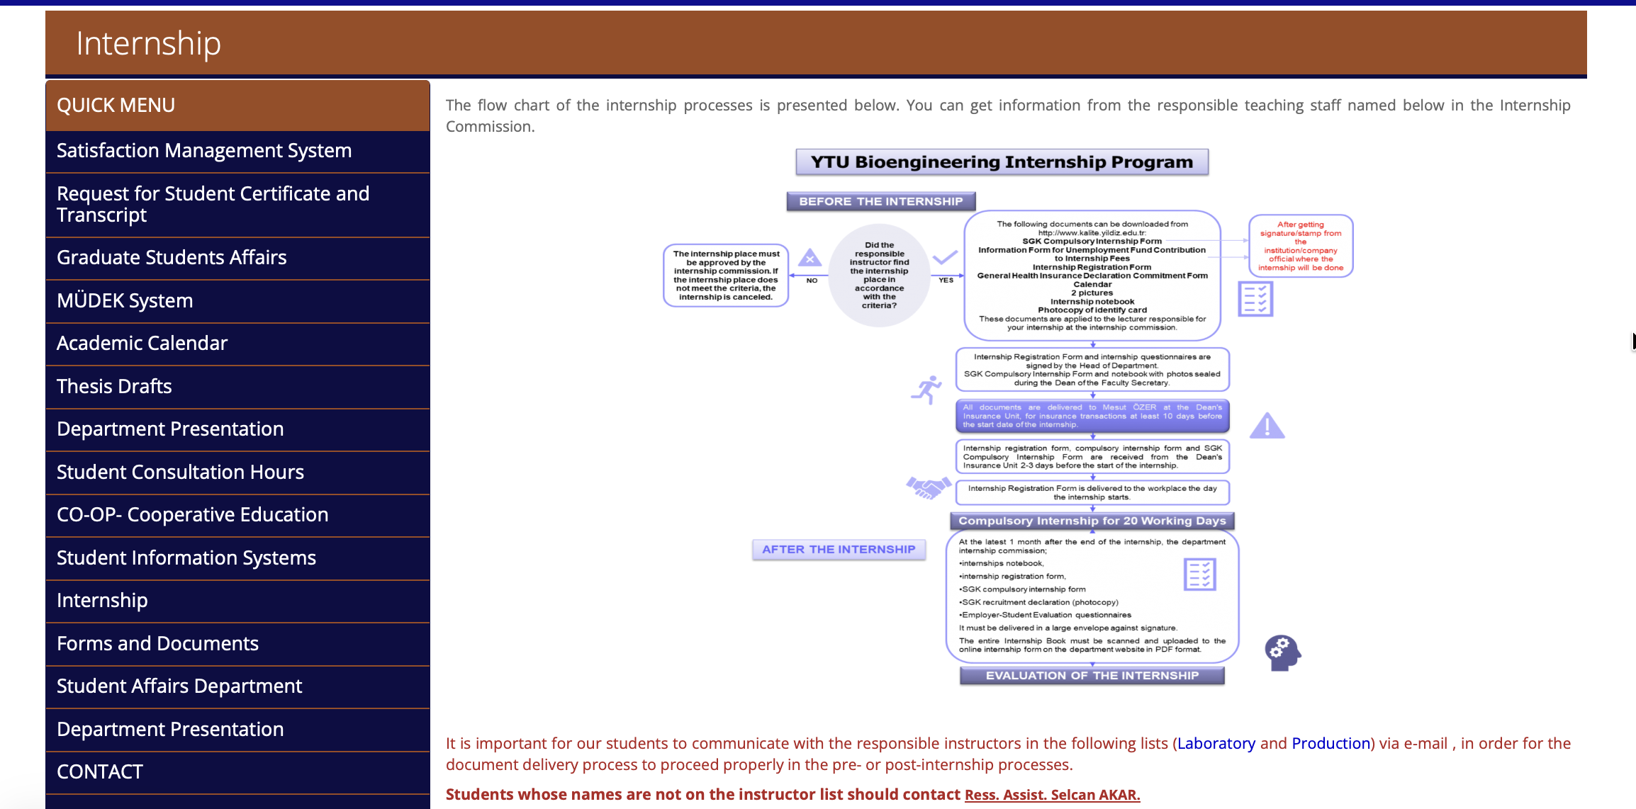
EDUCATION AND TRAINING
INTERNSHIP
YTU FACULTY OF CHEMICAL-METALLURGICAL
ENGINEERING
DEPARTMENT OF BIOENGINEERING

Slide 29
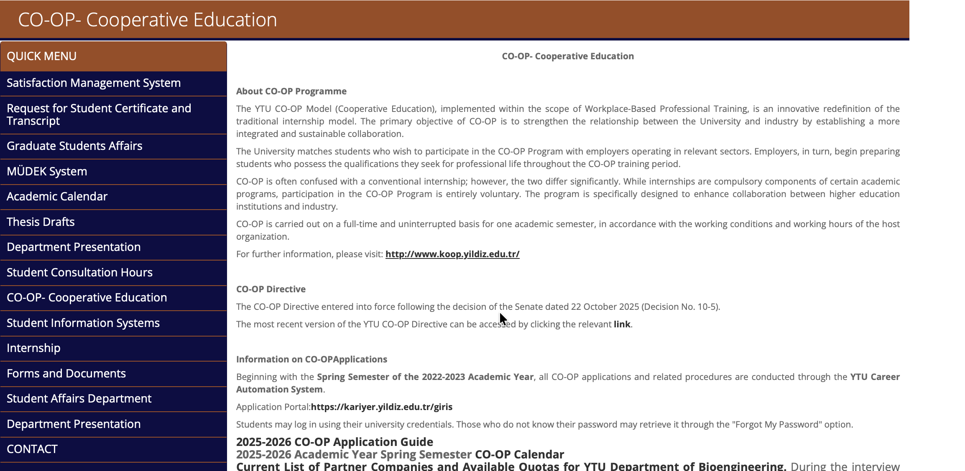
EDUCATION AND TRAINING
Cooperative Education (COOP)
The aim of the CO-OP (Cooperative Education) Program is to strengthen the relationship between the University and industry by fostering a more integrated and sustainable collaboration.
YTU FACULTY OF CHEMICAL-METALLURGICAL
ENGINEERING
DEPARTMENT OF BIOENGINEERING

Slide 30
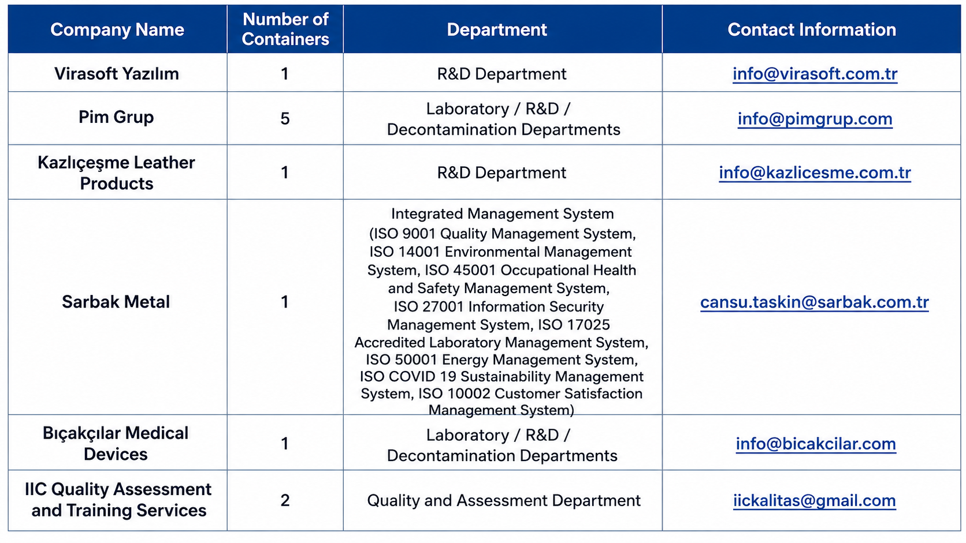
EDUCATION AND TRAINING
Cooperative Education (COOP)
The CO-OP (Cooperative Education) Program aims to strengthen the relationship between the University and industry by fostering closer and more sustainable collaboration.
Our Industry Partners (2024–2025 Academic Year)
YTU FACULTY OF CHEMICAL-METALLURGICAL
ENGINEERING
DEPARTMENT OF BIOENGINEERING

Slide 31
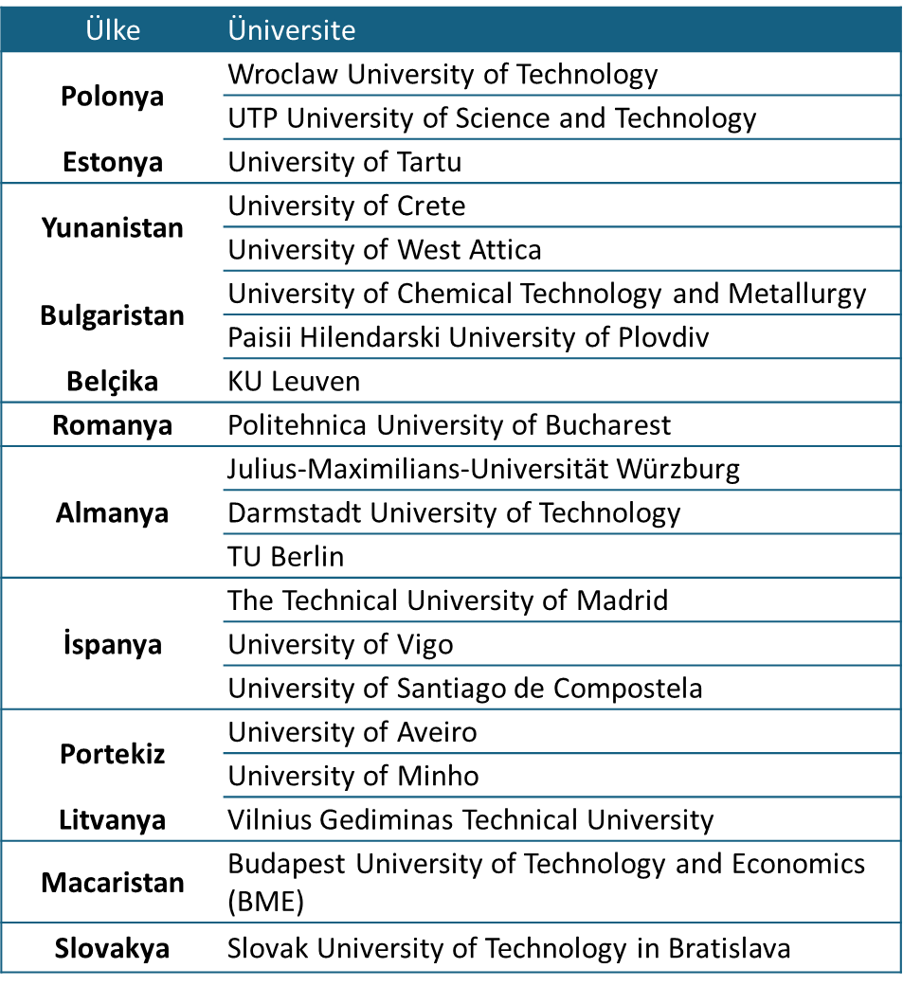
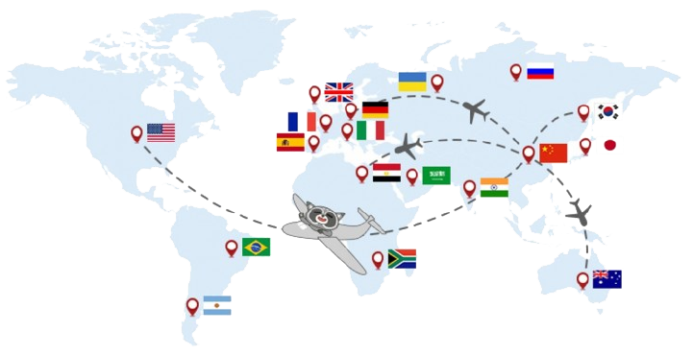
EDUCTION AND TRAINING
Partner Universities Under the Erasmus+ Program (2025)
Country
University
YTU FACULTY OF CHEMICAL-METALLURGICAL
ENGINEERING
DEPARTMENT OF BIOENGINEERING

Slide 32
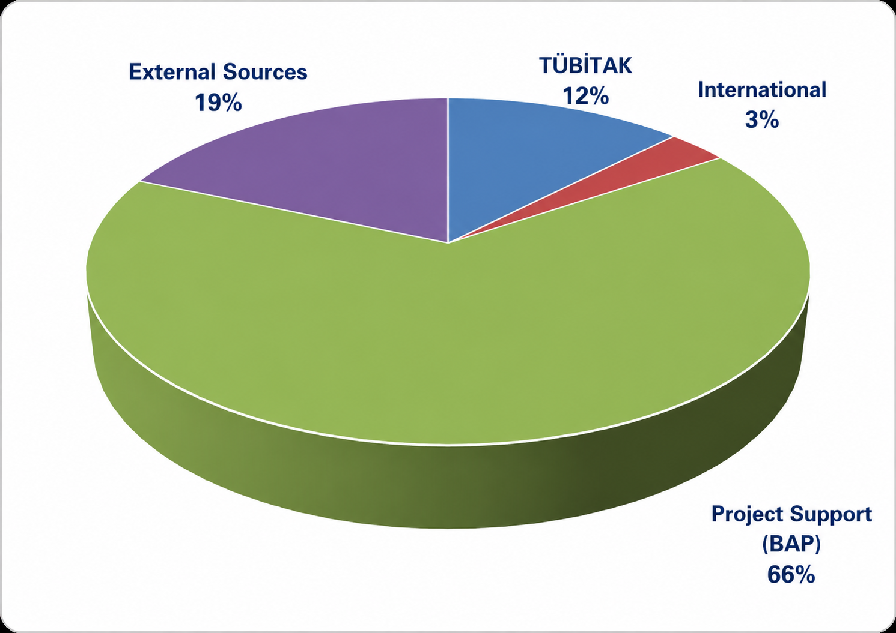

ACADEMIC PERFORMANCE
2025 PROJECTS
2025 PUBLICATIONS
YTU FACULTY OF CHEMICAL-METALLURGICAL
ENGINEERING
DEPARTMENT OF BIOENGINEERING

Slide 33
ACADEMIC PERFORMANCE
Our department makes a significant contribution each year to the University's international scientific publication output. In the 2024 academic performance rankings, our faculty members were frequently recognized among the University's top-performing Professors, Associate Professors, Assistant Professors, Lecturers, and Research Assistants.
In addition, our faculty members whose national and international patent applications have been granted received their certificates at the Academic Performance Awards Ceremony.
YTU FACULTY OF CHEMICAL-METALLURGICAL
ENGINEERING
DEPARTMENT OF BIOENGINEERING

Slide 34

ACADEMIC PERFORMANCE- STUDENT PROJECTS
(TÜBİTAK 2209 A/B)
During the 2024–2025 academic year, a total of 16 student research projects submitted by our students were awarded funding under the TÜBİTAK 2209-A University Students Research Projects Support Program, while 4 projects received funding under the TÜBİTAK 2209-B University Students Industry-Oriented Research Projects Support Program.

Slide 35
PEER MENTORING AND STUDENT REPRESENTATIVE
What Is Peer Mentoring?
Peer mentoring is a preventive and developmental support program in which students receive guidance from their peers to promote their personal, social, and academic development in a healthy and supportive environment.
Who Is a Peer Mentor?
A Peer Mentor is a Yıldız Technical University student who voluntarily participates in the Peer Mentoring Program, successfully completes the required training, and is selected by the Program Coordination Office.
Esin Şahsenem Karakurt
Contact:
sahsenem.karakurt@std.yildiz.edu.tr
A Student Representative is a Yıldız Technical University student who conveys students' expectations, requests, and concerns to the University's governing bodies and serves as a liaison between the students and the University administration.
YTU FACULTY OF CHEMICAL-METALLURGICAL
ENGINEERING
DEPARTMENT OF BIOENGINEERING
Y.T.Ü. KİMYA-METALÜRJİ FAKÜLTESİ
BİYOMÜHENDİSLİK BÖLÜMÜ

Slide 36


EXTRACURRICULAR ACTIVITIES
Biotechnology and Genetics Club̈
YTU FACULTY OF CHEMICAL-METALLURGICAL
ENGINEERING
DEPARTMENT OF BIOENGINEERING
Y.T.Ü. KİMYA-METALÜRJİ FAKÜLTESİ
BİYOMÜHENDİSLİK BÖLÜMÜ

Slide 37
CONTACT AND INFORMATIONS
Website: http://www.bioeng.yildiz.edu.tr/
Phone: 0 212 383 46 26
E-mail: bioeng@yildiz.edu.tr
Instagram: https://www.instagram.com/ytubiyomuh/
Twitter: https://twitter.com/YTUBiyomuh
Linkedin: https://www.linkedin.com/in/ytü-biyomühendislik/
Y.T.Ü., Department of Bioengineering,
Davutpaşa Campus
Faculty of Chemical and Metallurgical Engineering
34210 Esenler, Istanbul, Türkiye
YTU FACULTY OF CHEMICAL-METALLURGICAL
ENGINEERING
DEPARTMENT OF BIOENGINEERING
Y.T.Ü. KİMYA-METALÜRJİ FAKÜLTESİ
BİYOMÜHENDİSLİK BÖLÜMÜ

Slide 38

CONTACT AND INFORMATIONS
subject
Greetings
Which program?
Your name – surname ?
Student ID?
YTU FACULTY OF CHEMICAL-METALLURGICAL
ENGINEERING
DEPARTMENT OF BIOENGINEERING
Y.T.Ü. KİMYA-METALÜRJİ FAKÜLTESİ
BİYOMÜHENDİSLİK BÖLÜMÜ

Slide 39

CONTACT AND INFORMATIONS
WRONG
CORRECT
The XXXX-coded Biochemistry course, which I am retaking this semester after receiving a DD grade last year, conflicts with the Physics I course that I wish to enroll in.
???
Please provide detailed information in your petition/request so that we can understand your issue quickly and accurately.
YTU FACULTY OF CHEMICAL-METALLURGICAL
ENGINEERING
DEPARTMENT OF BIOENGINEERING
Y.T.Ü. KİMYA-METALÜRJİ FAKÜLTESİ
BİYOMÜHENDİSLİK BÖLÜMÜ

Slide 40
THANK YOU
YTU FACULTY OF CHEMICAL-METALLURGICAL
ENGINEERING
DEPARTMENT OF BIOENGINEERING
Y.T.Ü. KİMYA-METALÜRJİ FAKÜLTESİ
BİYOMÜHENDİSLİK BÖLÜMÜ

